Slide 1
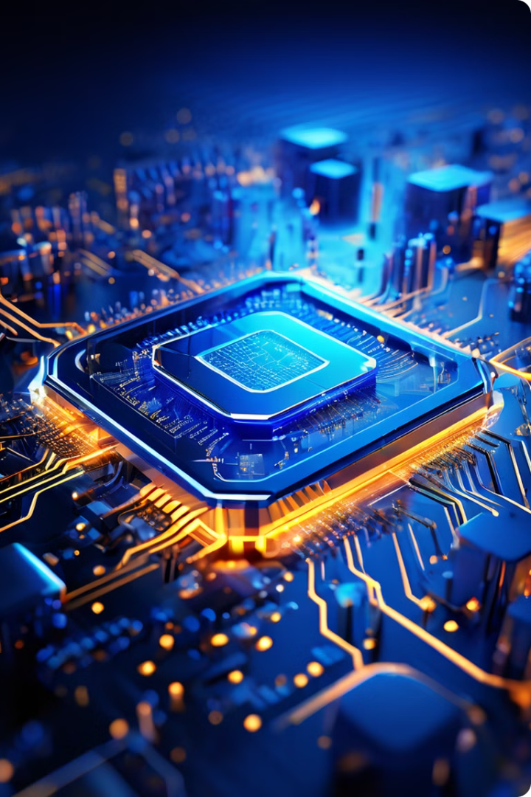


Introduction to Microprocessors
Microprocessors are the brains of computers and devices, processing instructions and managing data.
by Juvenile teachers

Slide 2
Central Processing Units (CPUs)
CPUs are designed for general-purpose computing tasks, handling instructions and managing system resources.
Strengths
Weaknesses
Excellent at multitasking and handling diverse workloads.
Less efficient at parallel processing, especially for complex tasks.
Good at managing system resources efficiently.
May struggle with graphics-intensive applications.

Slide 3
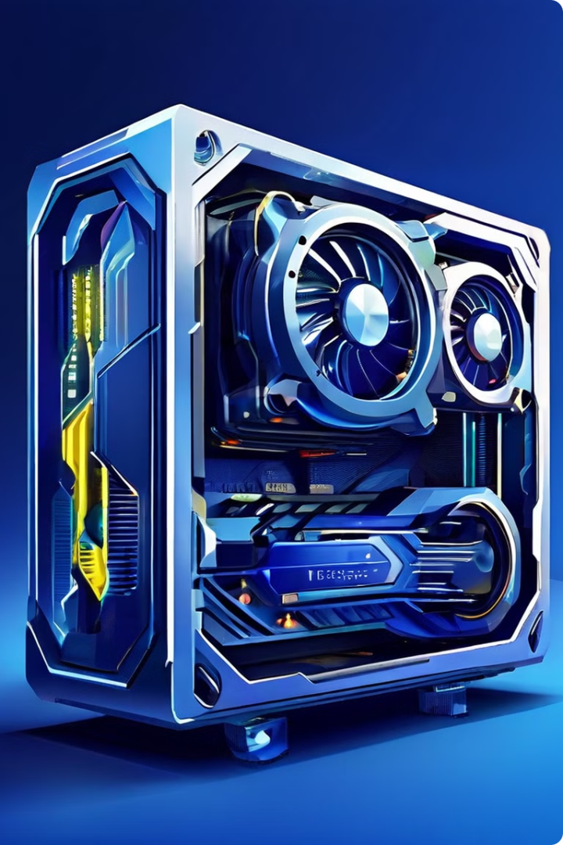
Graphics Processing Units (GPUs)
GPUs are specialized for parallel processing, excelling in graphics and computationally intensive tasks.
1
Parallel Processing
GPUs excel at handling large amounts of data simultaneously, accelerating tasks like image rendering.
2
Specialized Applications
They're commonly used in gaming, video editing, and scientific simulations.
3
Performance Benefits
GPUs offer significant speed increases in applications that can utilize their parallel processing capabilities.

Slide 4
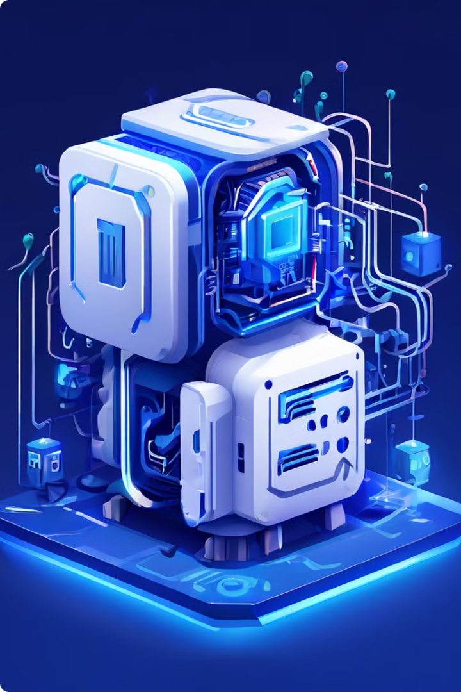
Neural Processing Units (NPUs)
NPUs are specialized for artificial intelligence (AI) tasks, performing calculations related to machine learning and deep learning.
AI Acceleration
NPUs are designed to handle the complex calculations required for AI algorithms, improving speed and efficiency.
Energy Efficiency
NPUs are often optimized for low power consumption, making them suitable for mobile devices and edge computing.
Emerging Technology
NPUs are a relatively new technology, but their role in AI is expected to grow significantly.

Slide 5
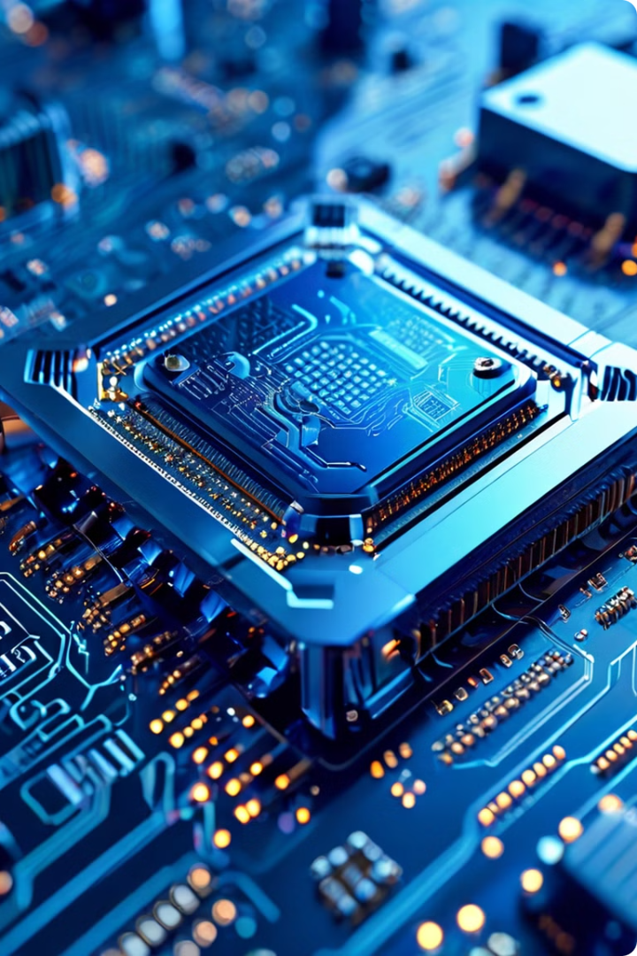
x86 Microprocessors
x86 processors are widely used in PCs and servers, known for their compatibility and robust instruction set.
Architecture
Complex Instruction Set Computing (CISC)
Instruction Set
Large and comprehensive, providing flexibility and compatibility.
Performance
Generally higher performance for complex tasks.
Power Consumption
Typically higher power consumption than ARM.

Slide 6
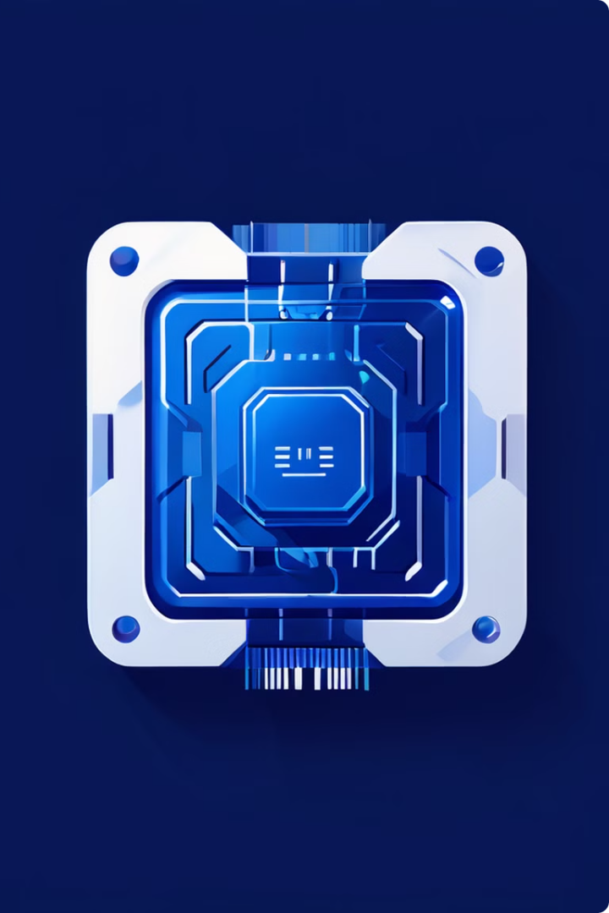




ARM Microprocessors
ARM processors are known for their energy efficiency and are commonly found in mobile devices, embedded systems, and IoT applications.
Architecture
Reduced Instruction Set Computing (RISC)
Instruction Set
Smaller and simpler, optimized for efficiency.
Performance
Typically lower performance than x86 for complex tasks.
Power Consumption
Significantly lower power consumption than x86.

Slide 7
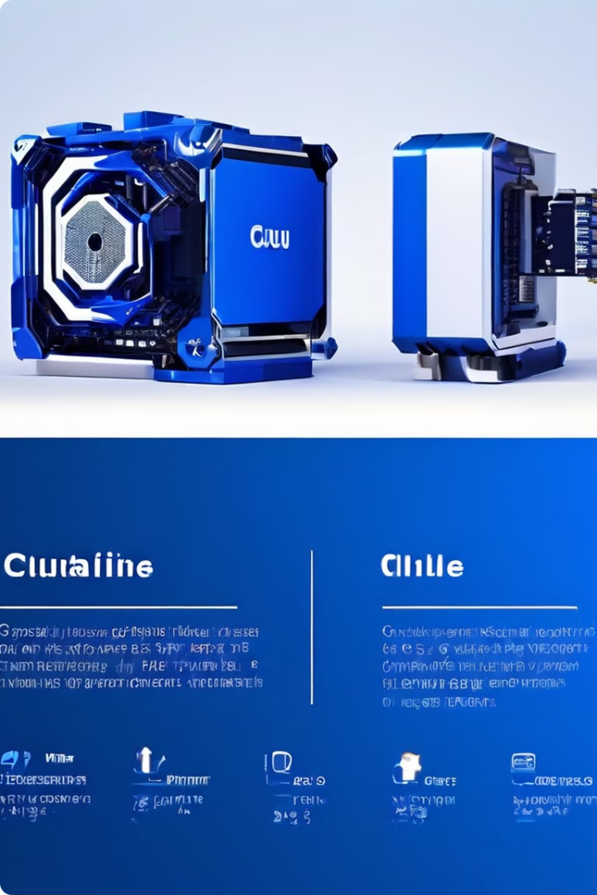



Key Differences between CPU, GPU, and NPU
CPUs are general-purpose, GPUs excel at parallel processing, and NPUs specialize in AI tasks.
CPU
General-purpose computing
GPU
Parallel processing for graphics and compute
NPU
Specialized for artificial intelligence tasks

Slide 8

Conclusion: Choosing the Right Microprocessor
The choice depends on the specific application's needs, balancing performance, power consumption, and cost.

